Slide 1

Introduction: memory representation, allocation and garbage collection.
Operations: Traversal, insertion and deletion.
Header linked lists: Grounded and Circular
Two-way lists: operations on two way linked lists

Slide 2
Introduction
Linked list
  Linear collection of self-referential class objects, called nodes
  Connected by pointer links
  Accessed via a pointer to the first node of the list
  Link pointer in the last node is set to null to mark the list’s end
Use a linked list instead of an array when
  You have an unpredictable number of data elements
  You want to insert and delete quickly.

Slide 3
Self-Referential Structures
Self-referential structures
  Structure that contains a pointer to a structure of the same type
  Can be linked together to form useful data structures such as lists, queues, stacks and trees
  Terminated with a NULL pointer (0)
Diagram of two self-referential structure objects linked together
  struct node {
  int data;
  struct node *nextPtr;
  };
nextPtr
  Points to an object of type node
  Referred to as a link
3
2
100
…
500
Data member and pointer
NULL pointer (points to nothing)
Notes:
A self referential data structure is essentially a structure definition which includes at least one member that is a pointer to the structure of its own kind.

Slide 4
Linked Lists
Types of linked lists:
  Singly linked list
    Begins with a pointer to the first node
    Terminates with a null pointer
    Only traversed in one direction
  Circular, singly linked
    Pointer in the last node points
    back to the first node
  Doubly linked list
    Two “start pointers” – first element and last element
    Each node has a forward pointer and a backward pointer
    Allows traversals both forwards and backwards
  Circular, doubly linked list
    Forward pointer of the last node points to the first node and backward pointer of the first node points to the last node

Slide 5
Linked Representation of Data
358
797
561
501
In a linked representation, data is not stored in a contiguous manner. Instead, data is stored at random locations and the current data location provides the information regarding the location of the next data.
  Adding item 498 on to the linked list
  Q: What is the cost of adding an item?
  Q: how about adding 300 and 800
  onto the linked list
  Deleting item 358 from the linked list
  Q: What is the cost of deleting an item?
  Q: What is the cost of searching for an item?
345
724
555
490
701
513
358
797
561
501
345
724
555
490
701
513
498
358
797
561
501
345
724
555
490
701
513
498

Slide 6
Linked List
How do we represent a linked list in the memory
  Each location has two fields: Data Field and Pointer (Link) Field.
Linked List Implementation
struct node {
  int data;
  struct node *link;
  };
  struct node my_node;
  Example:
START
Node Element
Data Field
Pointer (Link) Field
Null Pointer
1
300
5
2
500
0
NULL
3
3
100
4
4
200
1
5
400
2

Slide 7
Conventions of Linked List
There are several conventions for the link to indicate the end of the list.
a null link that points to no node (0 or NULL)
a dummy node that contains no item
a reference back to the first node, making it a circular list.

Slide 8

bat •
cat •
sat •
vat NULL

Slide 9


Linked-List Traversal
PTR
Step 1: [INITIALIZE] SET PTR = START
Step 2: Repeat Steps 3 and 4 while PTR != NULL
Step 3: Apply Process to PTR->DATA
Step 4: SET PTR = PTR->NEXT
[END OF LOOP]
Step 5: EXIT

Slide 10
Print the nos. of nodes in a Linked List
Step 1: [INITIALIZE] SET COUNT = 0
Step 2: [INITIALIZE] SET PTR = START
Step 3: Repeat Steps 4 and 5 while PTR != NULL
Step 4: SET COUNT = COUNT + 1
Step 5: SET PTR = PTR->NEXT
[END OF LOOP]
Step 6: Write COUNT
Step 7: EXIT

Slide 11
Search for an ITEM in a Linked List
Step 1: [INITIALIZE] SET PTR = START
Step 2: Repeat Step 3 while PTR != NULL
Step 3: IF VAL = PTR->DATA
SET POS = PTR
Go To Step 5
ELSE
SET PTR = PTR->NEXT
[END OF IF]
[END OF LOOP]
Step 4: SET POS = NULL
Step 5: EXIT

Slide 12
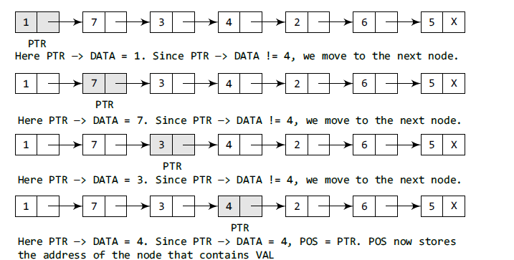
Search for an ITEM in a Linked List

Slide 13

Inserting a Node at the Beginning of a Linked List
Step 1: IF AVAIL = NULL
Write OVERFLOW
Go to Step 7
[END OF IF]
Step 2: SET NEW_NODE = AVAIL
Step 3: SET AVAIL = AVAIL->NEXT
Step 4: SET NEW_NODE->DATA = VAL
Step 5: SET NEW_NODE->NEXT = START
Step 6: SET START = NEW_NODE
Step 7: EXIT

Slide 14
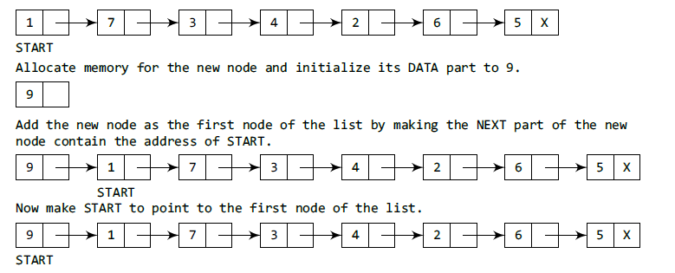
Inserting a Node at the Beginning of a Linked List

Slide 15
Inserting a Node at the End of a Linked List
Step 1: IF AVAIL = NULL
Write OVERFLOW
Go to Step 10
[END OF IF]
Step 2: SET NEW_NODE = AVAIL
Step 3: SET AVAIL = AVAIL->NEXT
Step 4: SET NEW_NODE->DATA = VAL
Step 5: SET NEW_NODE->NEXT = NULL
Step 6: SET PTR = START
Step 7: Repeat Step 8 while PTR->NEXT != NULL
Step 8: SET PTR = PTR->NEXT
[END OF LOOP]
Step 9: SET PTR->NEXT = NEW_NODE
Step 10: EXIT

Slide 16
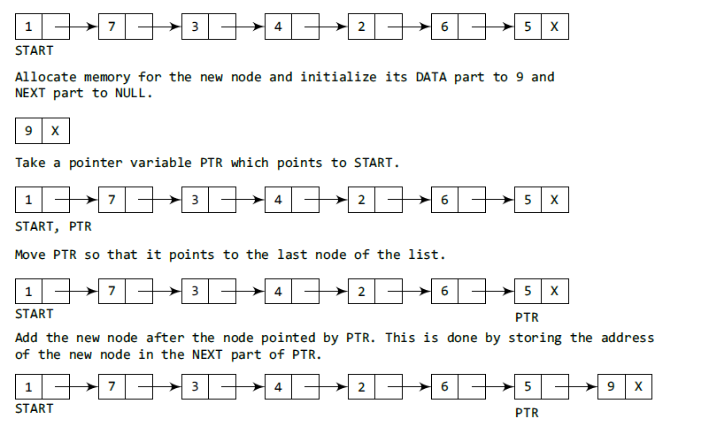
Inserting a Node at the End of a Linked List

Slide 17
Inserting a Node After a Given Node in a Linked List
Step 1: IF AVAIL = NULL
Write OVERFLOW
Go to Step 12
[END OF IF]
Step 2: SET NEW_NODE = AVAIL
Step 3: SET AVAIL = AVAIL->NEXT
Step 4: SET NEW_NODE->DATA = VAL
Step 5: SET PTR = START
Step 6:Repeat Steps 7 while PTR->DATA != NUM
Step 7: SET PTR = PTR->NEXT
[END OF LOOP]
Step 8: SET NEW_NODE->NEXT = PTR→NEXT
Step 9: PTR->NEXT = NEW_NODE
Step 10: EXIT

Slide 18
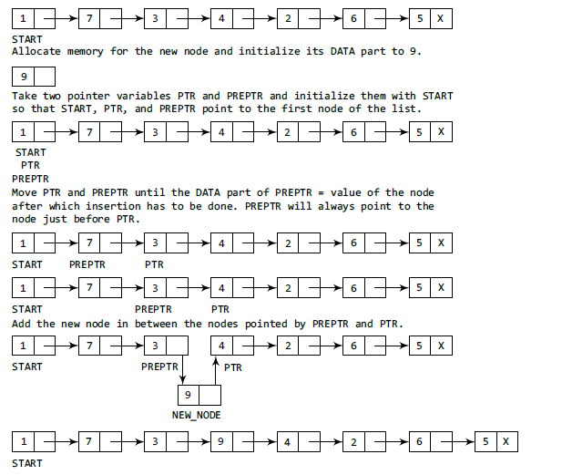
Inserting a Node After a Given Node in a Linked List

Slide 19

Inserting a Node Before a Given Node in a Linked List
Step 1: IF AVAIL = NULL
Write OVERFLOW
Go to Step 12
[END OF IF]
Step 2: SET NEW_NODE = AVAIL
Step 3: SET AVAIL = AVAIL->NEXT
Step 4: SET NEW_NODE->DATA = VAL
Step 5: SET PTR = START
Step 6: if PTR->DATA = NUM
SET NEW_NODE-> NEXT = START
SET START = NEW_NODE and EXIT
Step 7:Repeat while PTR->DATA != NUM
SET PREPTR = PTR
SET PTR = PTR->NEXT
[END OF LOOP]
Step 8: SET NEW_NODE->NEXT = PREPTR→NEXT
Step 9: PREPTR->NEXT = NEW_NODE
Step 10: EXIT

Slide 20

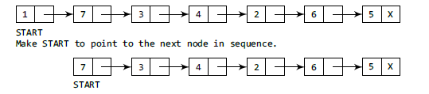
Deleting the First Node from a Linked List
Step 1: IF START = NULL
Write UNDERFLOW
Go to Step 5
[END OF IF]
Step 2: SET PTR = START
Step 3: SET START = START->NEXT
Step 4: FREE PTR or SET PTR -> LINK = AVAIL and AVAIL = PTR
Step 5: EXIT

Slide 21
Deleting the Last Node from a Linked List
Step 1: IF START = NULL
Write UNDERFLOW
Go to Step 8
[END OF IF]
Step 2: SET PTR = START
Step 3: Repeat Steps 4 and 5 while PTR->NEXT != NULL
Step 4: SET PREPTR = PTR
Step 5: SET PTR = PTR->NEXT
[END OF LOOP]
Step 6: SET PREPTR->NEXT = NULL
Step 7: FREE PTR or SET PTR -> LINK = AVAIL and AVAIL = PTR
Step 8: EXIT

Slide 22
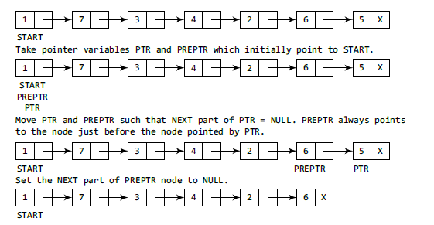
Deleting the Last Node from a Linked List

Slide 23
Deleting the Node After a Given Node in a Linked List
Step 1: IF START = NULL
Write UNDERFLOW
Go to Step 10
[END OF IF]
Step 2: SET PTR = START
Step 3: SET PREPTR = PTR
Step 4: Repeat Steps 5 and 6 while PREPTR->DATA != NUM
Step 5: SET PREPTR = PTR
Step 6: SET PTR = PTR->NEXT
[END OF LOOP]
Step 7: SET TEMP = PTR
Step 8: SET PREPTR->NEXT = PTR->NEXT
Step 9: FREE TEMP or SET TEMP -> LINK = AVAIL and AVAIL = TEMP
Step 10: EXIT

Slide 24
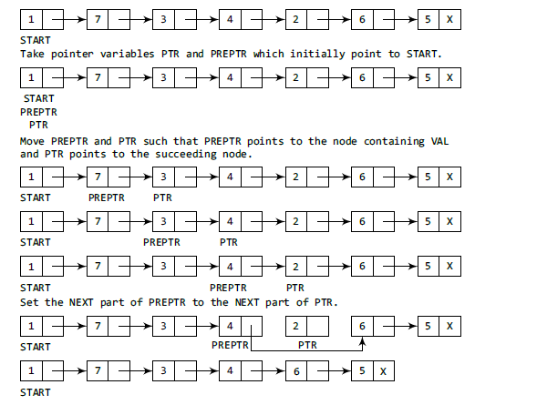
Deleting the Node After a Given Node in a Linked List

Slide 25

Circular Linked-List Traversal
Step 1: [INITIALIZE] SET PTR = START
Step 2: Apply Process to PTR->DATA
Step 3: PTR = PTR->NEXT
Step 4: Repeat Steps 5 and 6 while PTR != START
Step 5: Apply Process to PTR->DATA
Step 6: SET PTR = PTR->NEXT
[END OF LOOP]
Step 7: EXIT

Slide 26

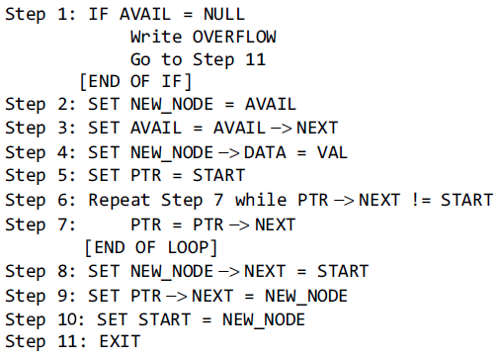
Inserting a Node at the Beginning of a Circular Linked List

Slide 27
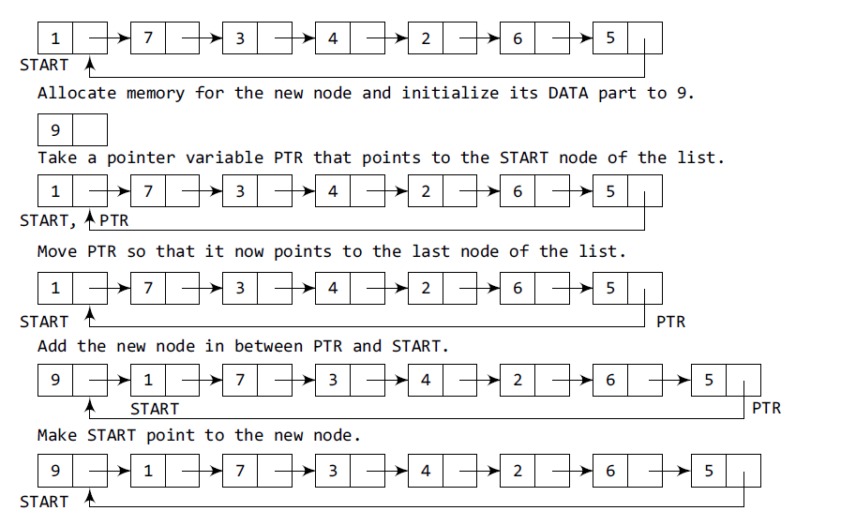
Inserting a Node at the Beginning of a Circular Linked List

Slide 28
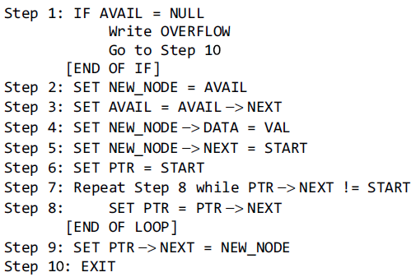
Inserting a Node at the End of a Circular Linked List

Slide 29
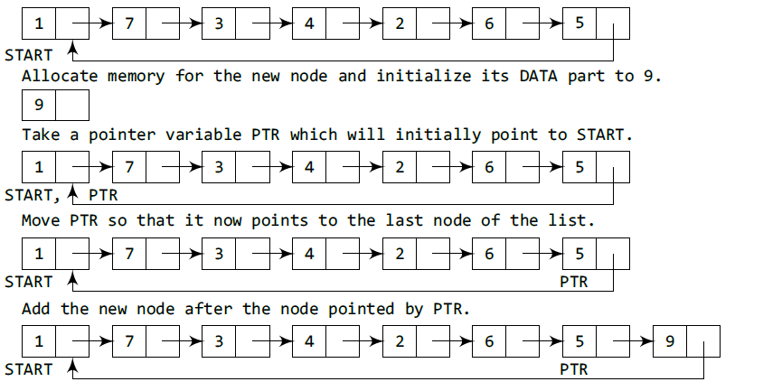
Inserting a Node at the End of a Circular Linked List

Slide 30
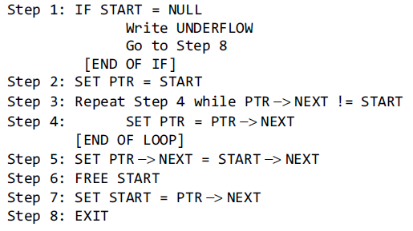
Deleting the First Node from a Circular Linked List

Slide 31
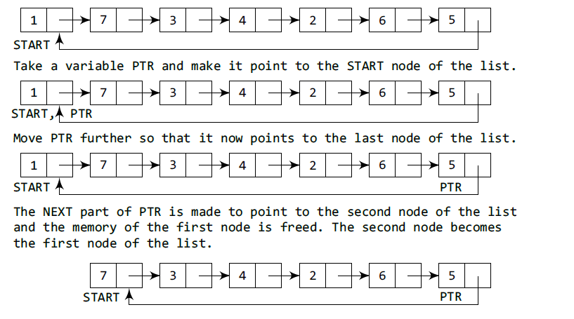
Deleting the First Node from a Circular Linked List

Slide 32
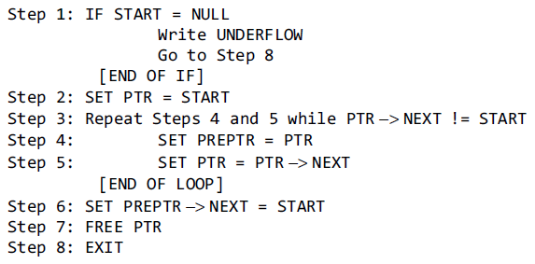
Deleting the Last Node from a Circular Linked List

Slide 33
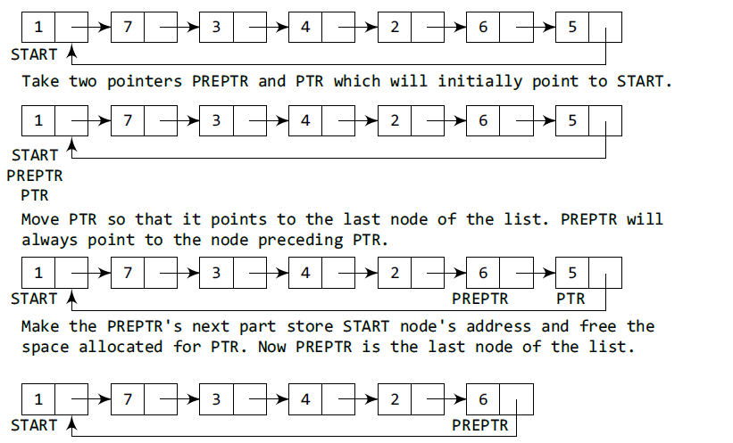
Deleting the Last Node from a Circular Linked List

Slide 34
Header Linked Lists
Header linked list is a linked list which always contains a special node called the Header Node, at the beginning of the list.
It has two types:
a) Grounded Header List
Last Node Contains the NULL Pointer
b) Circular Header List
Last Node Points Back to the Header Node
Header linked list
Grounded Header linked list
Circular Header linked list

Slide 35
Grounded Header Link List
A grounded header list is a header list where the last node contains the null pointer.
The term “grounded” comes from the fact that many texts use the electrical ground symbol to indicate the null pointer.
Start
Header Node
Figure: Grounded Header Link List

Slide 36
Circular Header Linked List
A circular header Link list is a header list where the last node points back to the header node.
The chains do not indicate the last node and first node of the link list.
In this case, external pointers provide a frame reference because last node of a circular link list does not contain null pointer.
Start
Header Node
Figure: Circular Header Link List

Slide 37
Benefit of using Header Node
One way to simplify insertion and deletion is never to insert an item before the first or after the last item and never to delete the first node
You can set a header node at the beginning of the list containing a value smaller than the smallest value in the data set
You can set a trailer node at the end of the list containing a value larger than the largest value in the data set.
These two nodes, header and trailer, serve merely to simplify the insertion and deletion algorithms and are not part of the actual list.
The actual list is between these two nodes.

Slide 38
Two-way lists
A two-way list is a linear collection of data elements, called nodes, where each node N is divided into three parts:
  Information field
  Forward Link which points to the next node
  Backward Link which points to the previous node
The starting address or the address of first node is stored in START / FIRST pointer .
Another pointer can be used to traverse list from end. This pointer is called END or LAST.

Slide 39
Two-way lists(cont…)
Every node (except the last node) contains the address of the next node, and every node (except the first node) contains the address of the previous node.
A two-way list (doubly linked list) can be traversed in either direction.

Slide 40
Representations of
Two-way lists
X
4
2
10
X
Start
Last
Prev Pointer
Next Pointer
Data Field

Slide 41

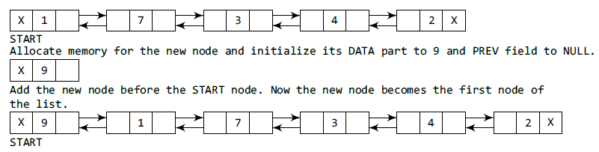
Inserting a Node at the Beginning of a Doubly Linked List
Step 1: IF AVAIL = NULL
Write OVERFLOW
Go to Step 9
[END OF IF]
Step 2: SET NEW_NODE = AVAIL
Step 3: SET AVAIL = AVAIL->NEXT
Step 4: SET NEW_NODE -> DATA = VAL
Step 5: SET NEW_NODE -> PREV = NULL
Step 6: SET NEW_NODE -> NEXT = START
Step 7: SET START -> PREV = NEW_NODE
Step 8: SET START = NEW_NODE
Step 9: EXIT

Slide 42
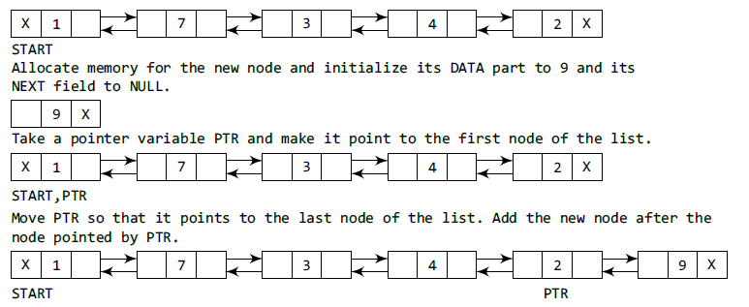
Inserting a Node at the End of a Doubly Linked List
Step 1: IF AVAIL = NULL
Write OVERFLOW
Go to Step 11
[END OF IF]
Step 2: SET NEW_NODE = AVAIL
Step 3: SET AVAIL = AVAIL -> NEXT
Step 4: SET NEW_NODE -> DATA = VAL
Step 5: SET NEW_NODE -> NEXT = NULL
Step 6: SET PTR = START
Step 7: Repeat Step 8 while PTR -> NEXT != NULL
Step 8: SET PTR = PTR -> NEXT
[END OF LOOP]
Step 9: SET PTR -> NEXT = NEW_NODE
Step 10: SET NEW_NODE -> PREV = PTR
Step 11: EXIT

Slide 43
Inserting a Node After a Given Node in a Doubly Linked List
Step 1: IF AVAIL = NULL
Write OVERFLOW
Go to Step 12
[END OF IF]
Step 2: SET NEW_NODE = AVAIL
Step 3: SET AVAIL = AVAIL -> NEXT
Step 4: SET NEW_NODE -> DATA = VAL
Step 5: SET PTR = START
Step 6: Repeat Step 7 while PTR -> DATA != NUM
Step 7: SET PTR = PTR -> NEXT
[END OF LOOP]
Step 8: SET NEW_NODE -> NEXT = PTR -> NEXT
Step 9: SET NEW_NODE -> PREV = PTR
Step 10: SET PTR -> NEXT = NEW_NODE
Step 11: SET PTR -> NEXT -> PREV = NEW_NODE
Step 12: EXIT

Slide 44
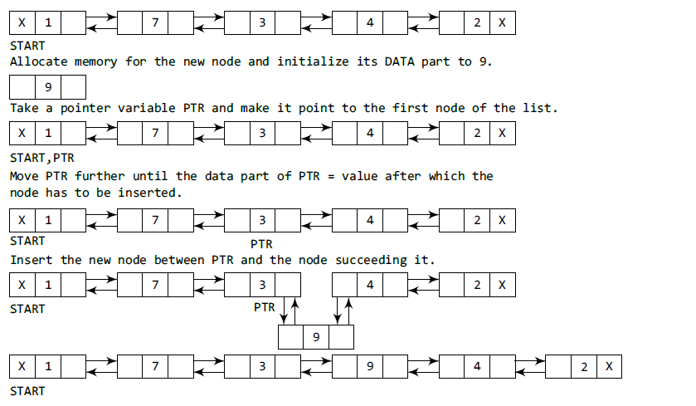
Inserting a Node After a Given Node in a Doubly Linked List

Slide 45

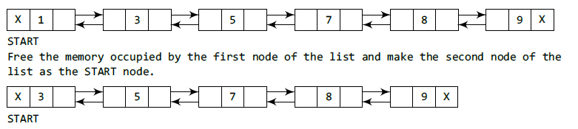
Deleting the First Node from a Doubly Linked List
Step 1: IF START = NULL
Write UNDERFLOW
Go to Step 6
[END OF IF]
Step 2: SET PTR = START
Step 3: SET START = START -> NEXT
Step 4: SET START -> PREV = NULL
Step 5: FREE PTR
Step 6: EXIT

Slide 46
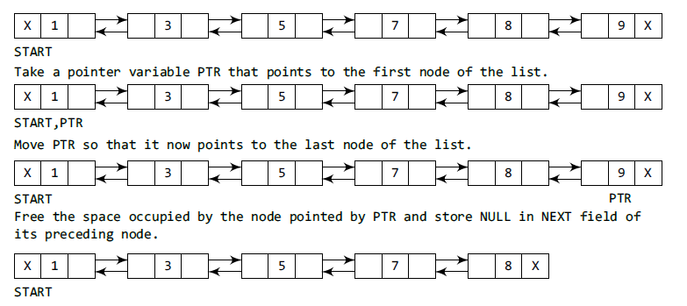
Deleting the Last Node from a Doubly Linked List
Step 1: IF START = NULL
Write UNDERFLOW
Go to Step 7
[END OF IF]
Step 2: SET PTR = START
Step 3: Repeat Step 4 while PTR -> NEXT != NULL
Step 4: SET PTR = PTR -> NEXT
[END OF LOOP]
Step 5: SET PTR -> PREV -> NEXT = NULL
Step 6: FREE PTR
Step 7: EXIT

Slide 47
Deleting the Node After a Given Node from a Doubly Linked List

Slide 48
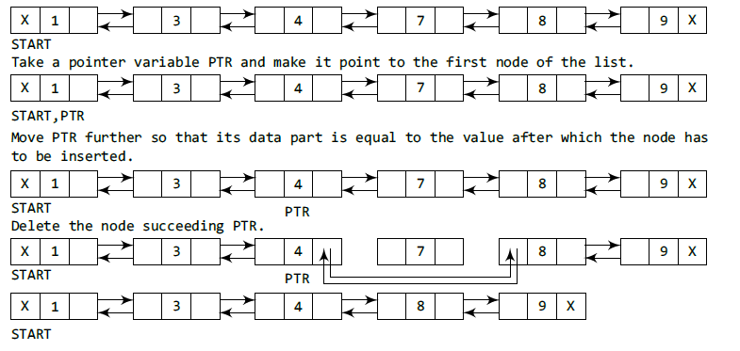
Step 1: IF START = NULL
Write UNDERFLOW
Go to Step 9
[END OF IF]
Step 2: SET PTR = START
Step 3: Repeat Step 4 while PTR -> DATA != NUM
Step 4: SET PTR = PTR -> NEXT
[END OF LOOP]
Step 5: SET TEMP = PTR -> NEXT
Step 6: SET PTR -> NEXT = TEMP -> NEXT
Step 7: SET TEMP -> NEXT -> PREV = PTR
Step 8: FREE TEMP
Step 9: EXIT

Slide 49
Deletion in 2-way Doubly LL
DELTWL(INFO,FORW,BACK,START,AVAIL,LOC)
1.SET FORW[BACK[LOC]]=FORW[LOC]
BACK[FORW[LOC]]=BACK[LOC]
2. SET FORW[LOC]=AVAIL and AVAIL=LOC
3.Exit

Slide 50
Insertion in 2-way Doubly LL
INSTTWL(INFO,FORW,BACK,START,AVAIL,LOCA,LOCB,ITEM)
1. IF AVAIL=NULL Set OVERFLOW and Exit
2. SET NEW=AVAIL and AVAIL=FORW[AVAIL], INFO[NEW]=ITEM
3.SET FORW[LOCA]=NEW,FORW[NEW]=LOCB,
BACK[LOCB]=NEW, BACK[NEW]=LOCA
4.Exit

Slide 51
Thank You

